Slide 1
My wellness
“prevention is right choice than the occurrence of problem”

Slide 2
FEATURES
Profile & health profile
Voice-care assistant
Testing & monitoring
Food & immune system
Search
Health tips
Interactive sessions
Health progress
Scanner
Other icons like time reminder, notifications etc.

Slide 3














MAIN PAGE VIEW
Profile
108
Reminder
Scanner
Notifications
Progress
Health
profile
“Expand your life span with one right choice”
MY WELLNESS
Testing & monitoring
Food & immune system
Health tips
Interactive sessions
Voice-care navigator
Search

Slide 4


PROFILE AND HEALTH PROFILE
Profile
This displays the basic details of the user.
Help
Edit
Name :
Age :
Gender :
Help
Phone no. :
Edit
Email id :
Address :
Blood Group :
Do u any health problems?
YES
NO
Name of disease :
Stage :
Update
Type of disease :
Do u want to be monitored and auto update your health profile ?
Health profile
YES
NO
This displays the health details of the user.
Update

Slide 5
VOICE-CARE ASSISTANT
This page is automatically navigated after the sign up page.
It displays whether the user want voice-care assistant or not.
When the user clicks ‘YES’ then everything is assistant through voice.
The user can turn ‘ON’ and ‘OFF’ whenever they want.
Do u need an voice-care assistant to navigate u through this application ?
YES
NO

Slide 6


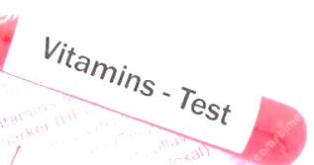

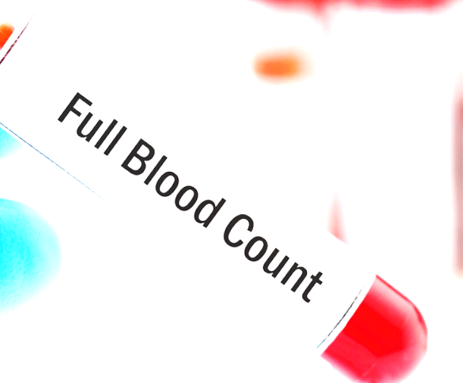
TESTING AND MONITORING
Tests available based on Your health profile
Can also search other tests
This displays the tests and monitoring system of the user.
1. Vitamins test
Test includes :
MONITOR
2. Full body checkup
Test includes :
MONITOR
Test includes :
3. Blood count
MONITOR

Slide 7


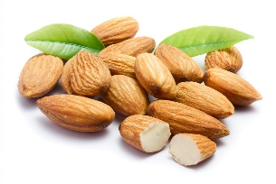

FOOD AND IMMUNE SYSTEM
This will displays food to be taken based on the age and health profile.
This page also displays the recommended food to try which helps us to be more health conscious.
1. Citrus fruits :
Immune rate
Vitamin C is often said to be the best way to improve our immune system….
2. Almonds :
Immune rate
Almonds come first in number of rich in vitamin E….
We also recommend you to try this food also to be more health conscious
1. Green tea :
Green tea has a lot of flavonoids and antioxidants called epigallocatechin gallate or EGCG, which helps in boosting the immune system….
Immune rate

Slide 8


SEARCH
This displays the search bar where you search the medicines, detailed information about diseases, and etc.
We can also use the camera to capture the tablet strip then when it searches it will provide the detailed view of the tablet and dosage limit too.
Search here….!
Search anything related to health, medicines, diseases…etc.

Slide 9

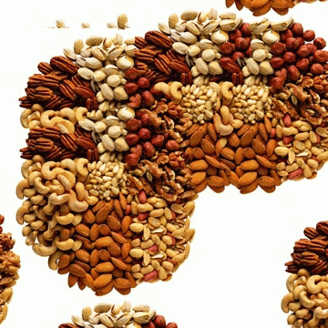
HEALTH TIPS
This displays the health tips based on the health profile.
This also recommend the simple health tips to follow to prevent the health issues.
They can also filter the tips based on there requirement.
Recommended tips based on your health profile
Filters
1. Exercise:
Helps you to control your weight.
Reduce your risk of heart diseases.
Improve mental health and mood.
Strengthen your bones and muscles’
Helps your body to manage blood sugar and insulin levels….
2. Nuts and seeds:
They provide healthy fats, protein, vitamins, and minerals for the diet.
They help to regulate body weight by reducing food intake, increasing energy expenditure, and preventing fat absorption…..

Slide 10

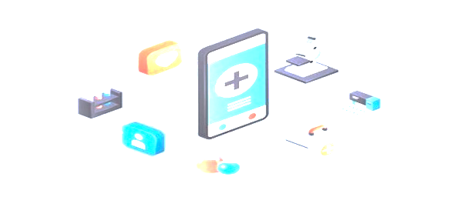
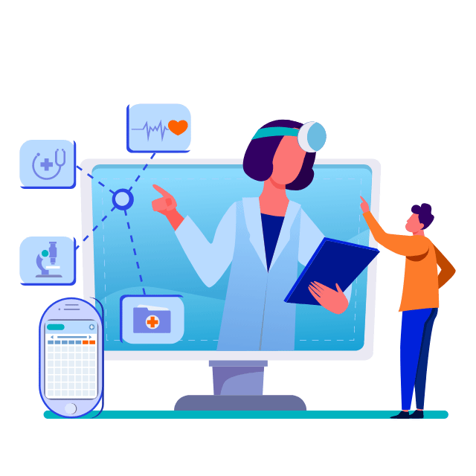

INTERACTIVE SESSIONS
This displays the interactive sessions between the expert doctor and the user.
The sessions are very useful to the user regarding the preventive tips, relief of stress and many more.
The user can also chat with the doctors using the group chat.
Upcoming
Completed
Downloaded
Session 1 :
Session 2 :
Group chat

Slide 11

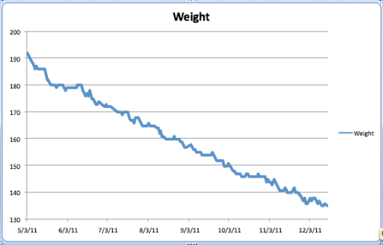
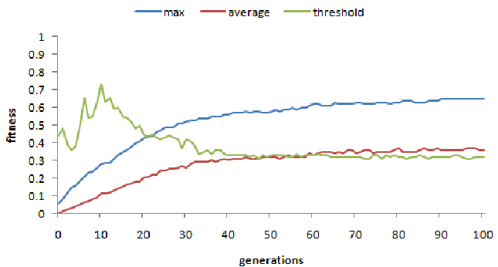
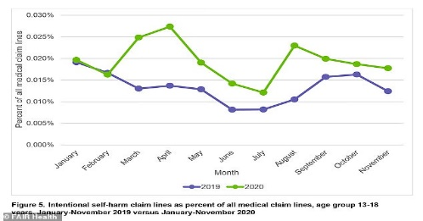
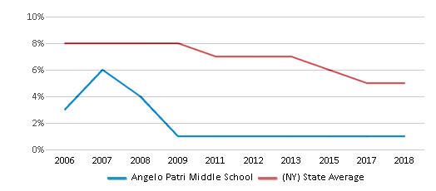
HEALTH PROGRESS
This page displays the progress of health related to the test which as be monitored.
It also provides the detailed updates about the health from time to time.
1. Name of test monitored :
2. Name of test monitored :
3. Name of test monitored :
4. Name of test monitored :

Slide 12

SCANNER
This page displays the scanner which is used to scan any real world object whether it contains any harmful micro particles or not.
It also displays whether the particle is harmful or not.
HARMLESS
HARMFUL
Problems may cause with this particles.
Preventive solutions to get rid from this health problems
There is no health problem with this micro particles.

Slide 13




TIME REMIDER
This page remands us to take food, pills reminders and many more.
They also remands about the health progress updates too.
It’s time to do exercise
It’s time to take your food
It’s time to take your medicines
It’s time go to sleep

Slide 14
NOTIFICATIONS
This page notifies us about all updates of the app.
It also sends us about updates health progress, sessions, profile and etc.
Interactive sessions starts in 10 minutes
Your health progress for this week is here
Your health profile has been updated
Your downloads will be available here

Slide 15
Thank you
Best regards,
Team Incredibles

